Slide 1



DSCI 6051-02 : DATA SCIENCE CAPSTONE PROJECT

Slide 2
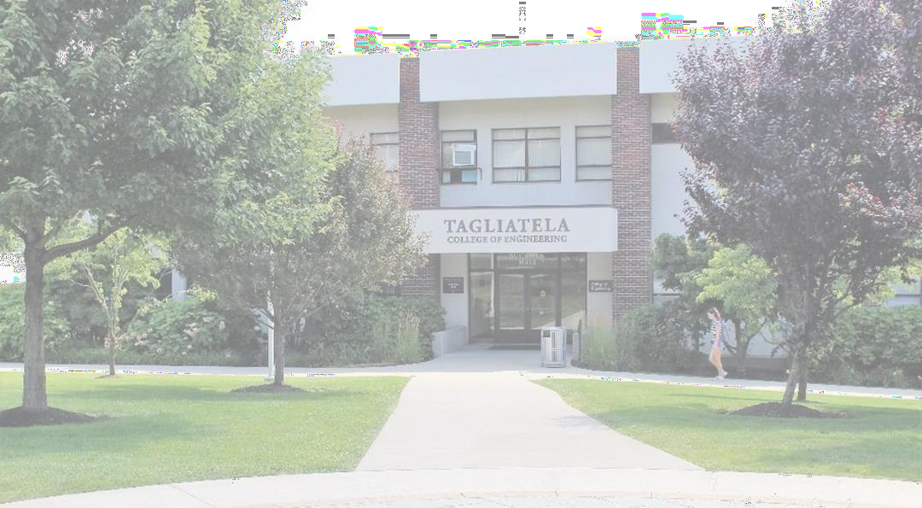
ADM-DM_PROJECT ADMISSION MODEL FOR DECISION MAKING
Advisors:
Dr.Ardiana Sula
Dr. Muhammad Aminul Islam

Slide 3


© 2023 University of New Haven
3
AGENDA
Welcome
ADM-DM
Project: Final Presentation
Project Introduction
OCR Model Enhancement and Deliverables
ADM-DM: GUI Demo
AdM-DM: Recommendations and Next Steps

Slide 4




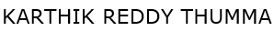

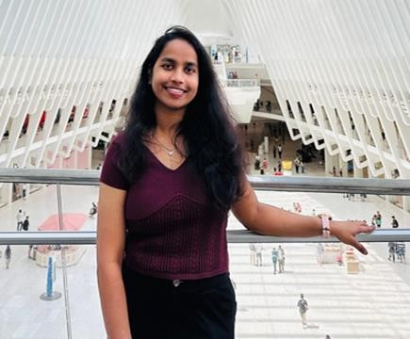
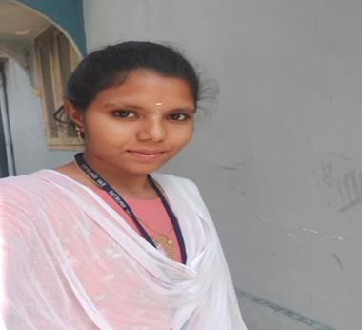
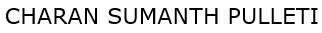



TEAM
© 2023 University of New Haven
3

Slide 5
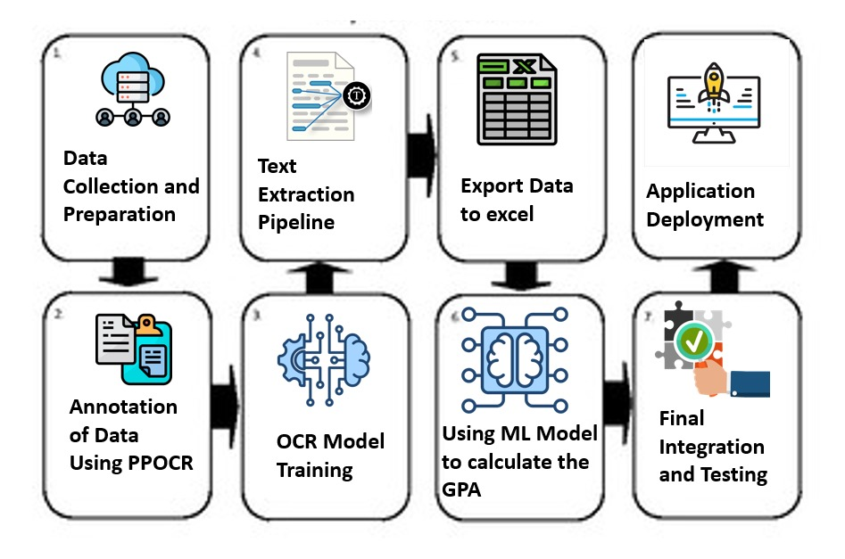
Project Pipeline

Slide 6

Why ADM-DM Project?
© 2023 University of New Haven
10
Complexities of University Admission
Admission entails assessing and choosing candidates according to a number of criteria.
Academic achievement
Experience in the workplace
SOP and LOR Requirements
Suggestion for a scholarship
The process becomes significantly more difficult and time-consuming when there are several application

Slide 7
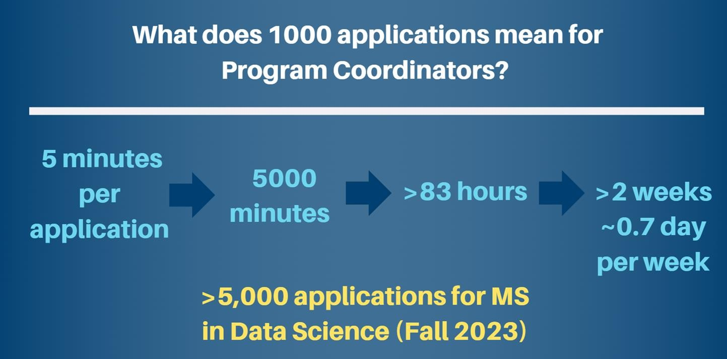
Why ADM-DM Project?
© 2023 University of New Haven
11

Slide 8
Introduction & Objectives
© 2023 University of New Haven
6
Automate transcript data extraction and GPA prediction to streamline university admissions and reduce errors.
Problems Unstructured and diverse transcript formats make manual processing time-consuming and error-prone, creating bottlenecks in admissions.
Scope
Use OCR tools to extract structured transcript data (e.g., grades, courses).
Build a GPA prediction model integrated into a user-friendly interface to automate admission decisions (Admit/Reject).

Slide 9


12
© 2023 University of New Haven
© 2023 University of New Haven_{Power}12_{ON}
Problems
Problem #1
Efficiency Time-Consuming Manual Review
Problem #2 Fairness Inconsistent Admissions
Decisions (Fairness)
Problem #3 Scaling to order programs Scalability Challenges

Slide 10
PROBLEM SOLVING
© 2023 University of New Haven
7
SOLUTION-1
SOLUTION-2
SOLUTION-3
Paddle OCR for Automation: Used Paddle OCR TO Automate transcript conversion into structured text, reducing manual data entry and gives better Efficiency
Post-Processing and Annotation:
Implemented standardized GPA predictions to ensure consistent and unbiased admission decisions.
Scalability Challenges
Leveraged GUI Interface to handle high transcripts and admissions data efficiently.
01
02
03

Slide 11
Workflow Design
Phase-I: Data Preparation
Understanding the Data and performing the Annotations
Training Data
Phase-II: Model Enhancement
Fine-Tuning the data and Enhancing the noisy images
Rewriting the Previous Model
Phase-III: GUI Interface
All the Backend Work was hidden and Showcasing the Front-end version

Slide 12
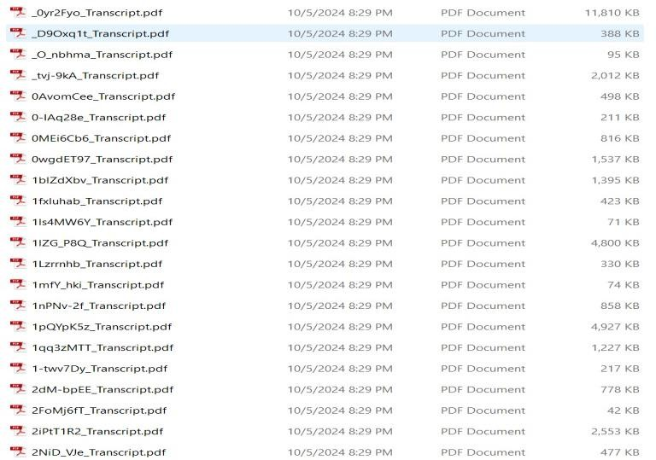
Data Understanding
© 2023 University of New Haven
9
Data Sources:
Collected various academic transcripts in formats like JPEG, PNG, and PDF.
Exploration:
Manually annotated noisy transcripts to identify key fields like course names, grades, and CGPA.
Challenges:
Poor image quality in some transcripts.
Missing or inconsistent data requiring manual correction.

Slide 13
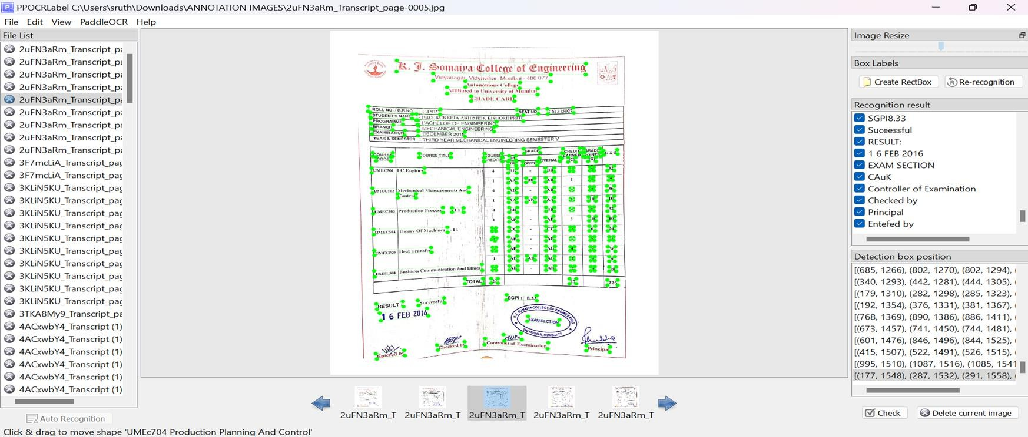
Annotation of Transcripts using paddle OCR Tool
© 2023 University of New Haven
10

Slide 14
Data Preparation and Training
© 2023 University of New Haven
11
Preparation Steps:
Collected training data in JSON format data from PPOCRLabel Tool.
Performed Training on the Labelled Data using PaddleOCR, PaddlePaddle (GPU version).
Challenges:
Handling noisy images with low resolution.
Phase-I Deliverables:
A structured labeled data in JSON format from PPOCRLabel tools.
Performed Training for the extracted data.

Slide 15
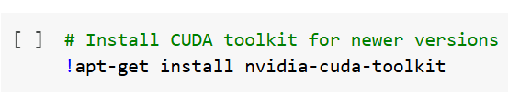
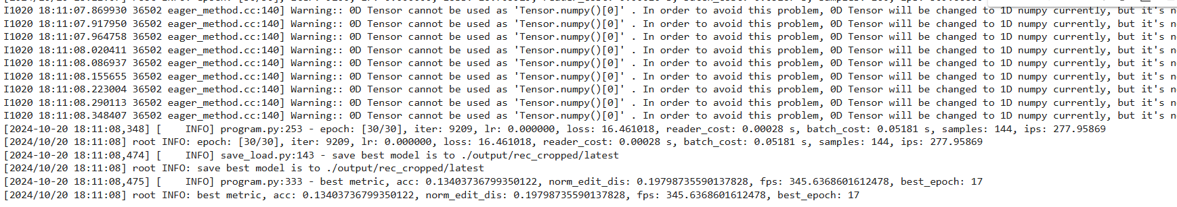
Data Preparation Outputs

Slide 16

Built Model
© 2023 University of New Haven
13
Models Built:
Fine-tuned PaddleOCR for text recognition and table detection.
Integrated super-resolution for the noisy images for enhanced OCR accuracy.
Training Process:
Preprocessed, split datasets, and fine-tuned hyperparameters.
Model Assessment:
Achieved high precision, recall, and F1-scores with robust evaluation..

Slide 17
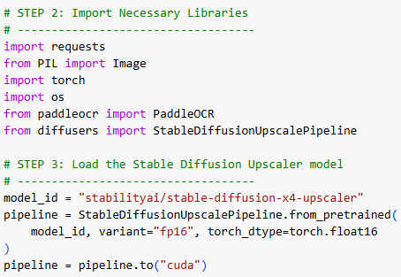
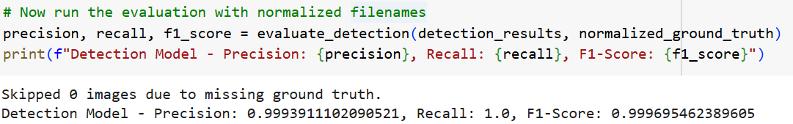
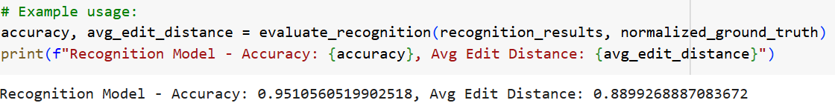
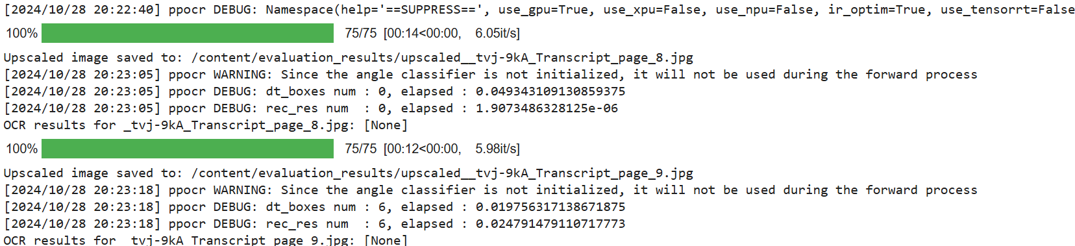
© 2023 University of New Haven
13
OCR model accuracy

Slide 18
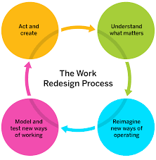
Work From the Previous Semester
Work in this Semester
We developed an enhanced OCR model with improved performance and redefined metrics to ensure more accurate data extraction. This advanced model is versatile and can be applied across universities, enabling structured data extraction and seamless organization into XML format.
The OCR model from previous work encountered challenges in extracting data in a structured and organized format. As a result, the data was manually curated to enable accurate performance evaluation.

Slide 19
Evaluation
© 2023 University of New Haven
14
Model Results:
Our OCR model demonstrated over 90% accuracy in extracting text from transcripts, significantly outperforming models used in previous semesters
This Extracted Data was Organized in a better Structured manner in XML format.
Next Steps:
We designed the OCR model to be highly adaptable, capable of working with transcripts from most universities, and delivering organized, structured outputs.
Subsequently, the model was saved in a .pkl format and integrated into an interface to ensure seamless and accurate performance.
Phase-II Deliverables:
Fine-tuning the data and getting better Accuracies for the model.
Enhancing the Previously used OCR model into a better version.

Slide 20
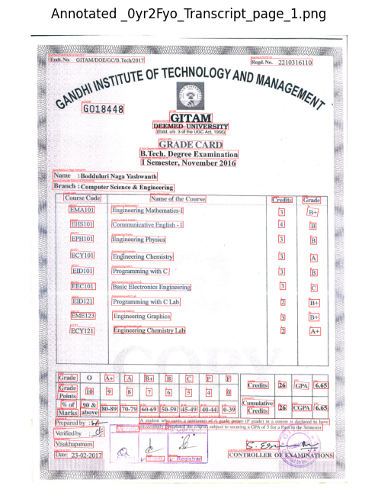
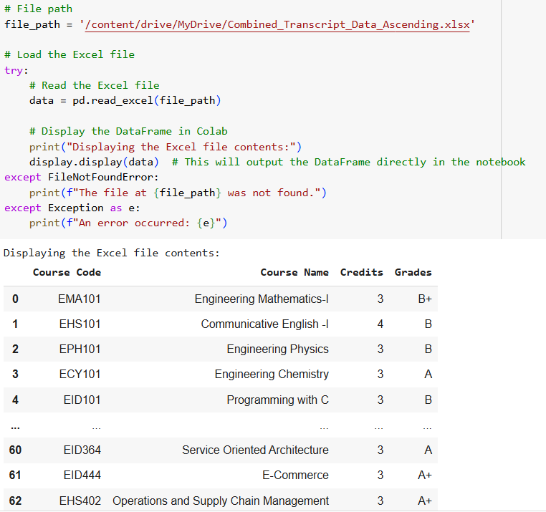
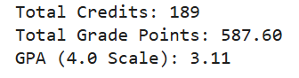
© 2023 University of New Haven
16

Slide 21
Deployment
© 2023 University of New Haven
15
MVP/Product Demo:
Developed a GUI where users can upload transcripts in PDF format.
The system extracts data, predicts GPA.
Key Features:
User-friendly interface with drag-and-drop functionality.
Real-time feedback on transcript processing.
Visualization of extracted data in a tabular format.
Outcome:
A scalable tool for universities to streamline their admission process.
Phase-III Deliverables:
GUI Interface

Slide 22

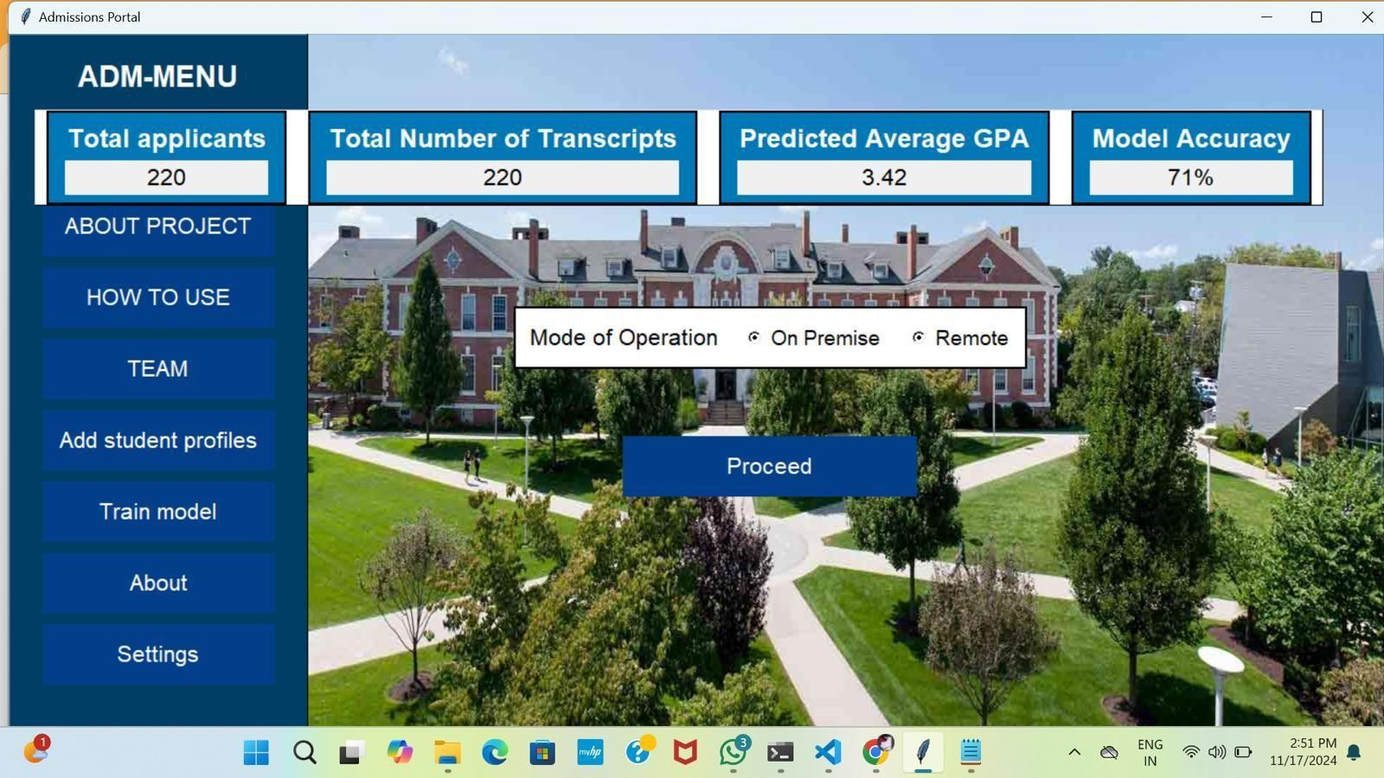
Application Interface
©©22002233 UUnniivveerrssiittyy ooff NNeeww HHaavveenn
197

Slide 23
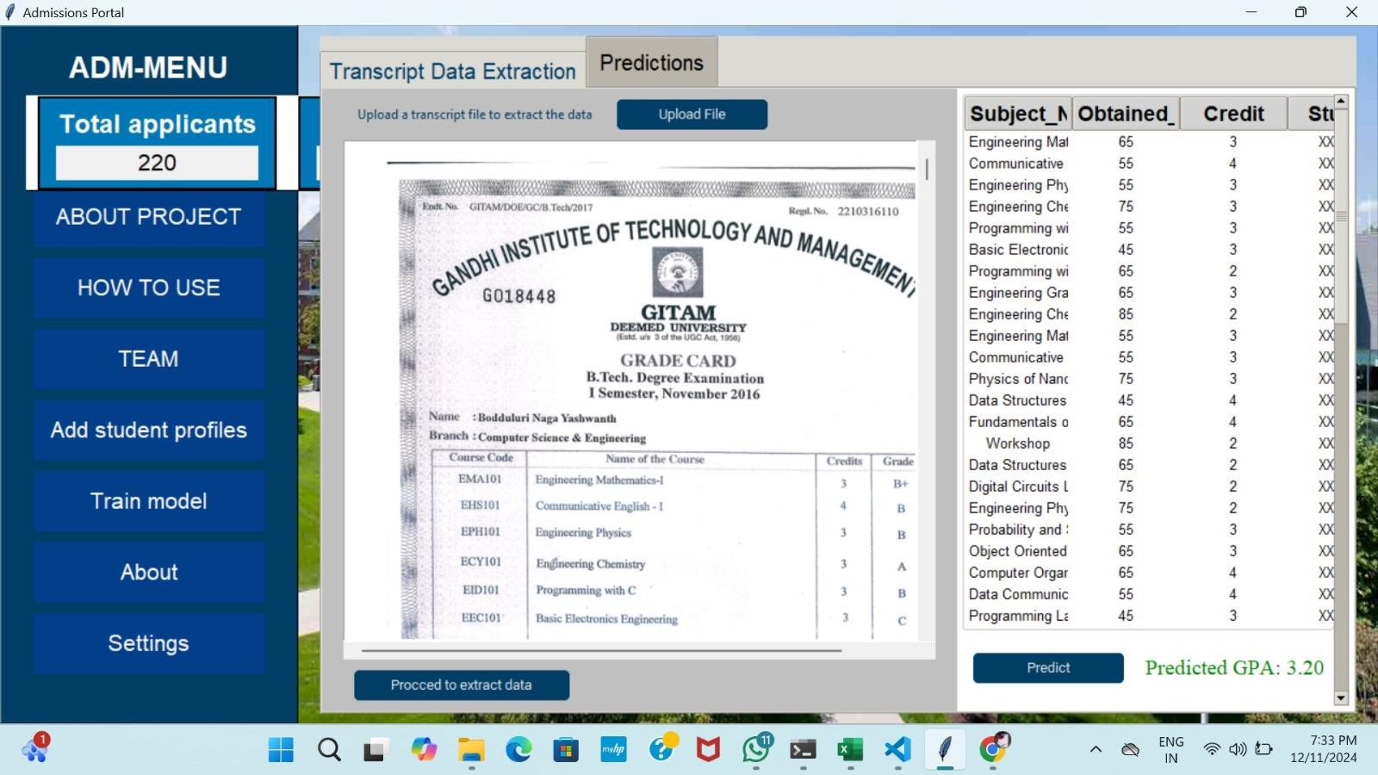
© 2023 University of New Haven
18

Slide 24
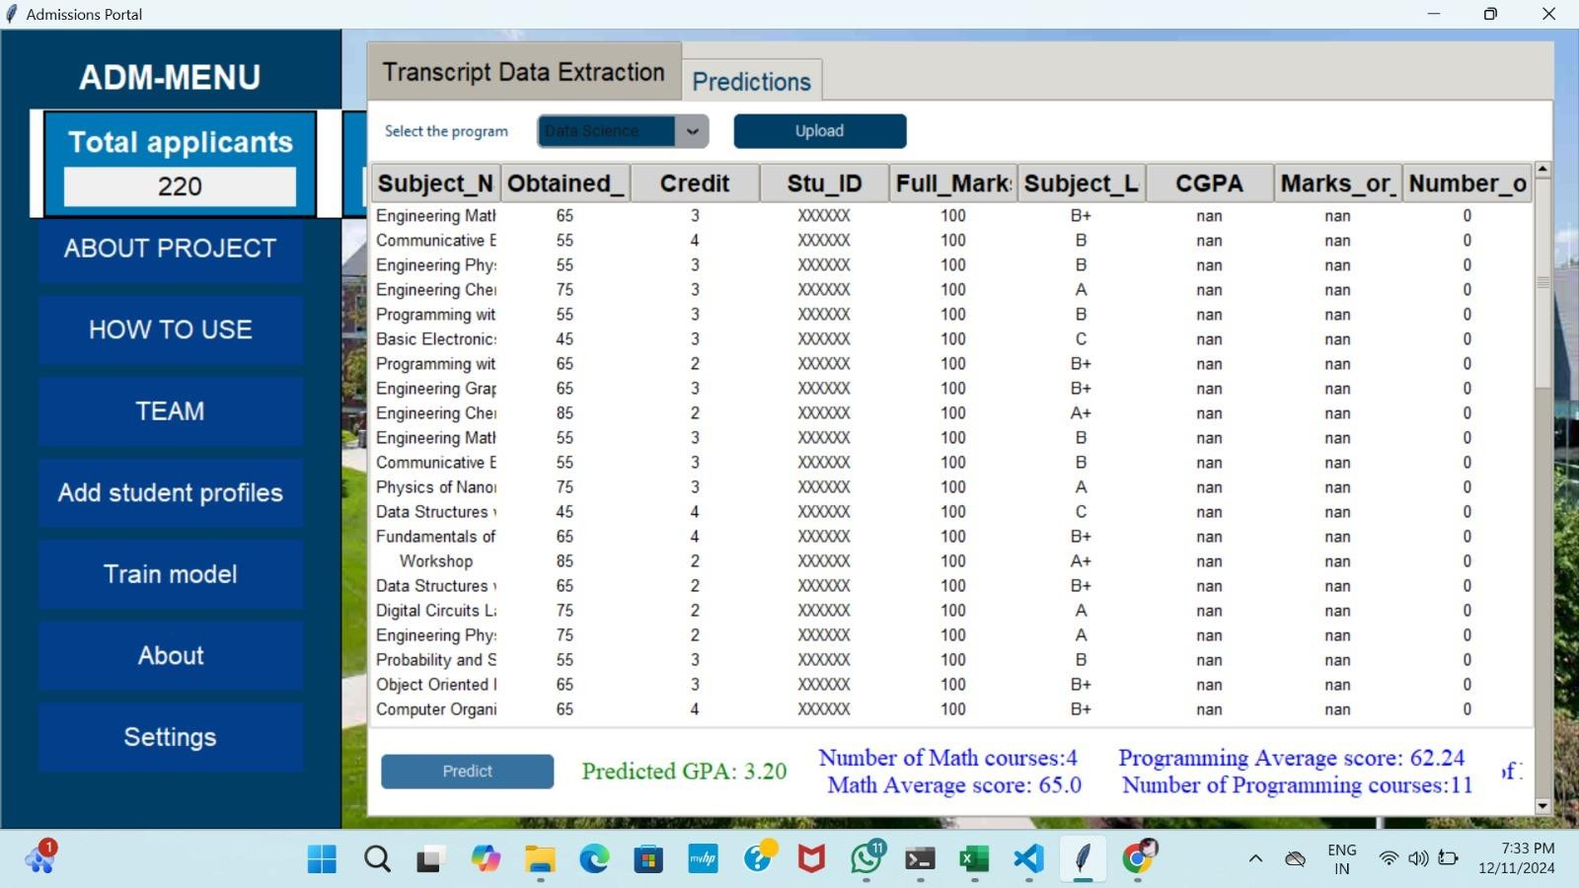
© 2023 University of New Haven
19

Slide 25
What We Learned
© 2023 University of New Haven
20
New Tools & Technologies:
We gained hands-on experience in annotation, training OCR models, and integrating machine learning models for GPA prediction into an automated pipeline.
This involved post-processing text, structuring data, and exporting results in user-friendly formats like Excel and JSON.
We also learned deployment practices to create a functional interface for real-world usability.
The project improved our skills in problem-solving, workflow optimization, and handling large datasets, while fostering independent research and learning.

Slide 26
Future Recommendations
© 2023 University of New Haven
21
Enhancements:
Integrate multilingual OCR capabilities to handle non-English transcripts
Scalability and De-risking: Scale the model effectively to handle a larger number of applications while minimizing risks associated with deploying AI in decision-making processes.​
Develop Decision Support Models for Other Programs: Expand the model's application to other educational programs for broader usability.
​Build a UNH ADM-DM Data Pipeline (Data Lake): Develop a robust data management infrastructure, like a Data Lake, for efficient data storage, processing, and retrieval.​

Slide 27
© 2023 University of New Haven
21
Future Recommendations
Long-Term Applications:
Extend the tool to predict additional outcomes, such as scholarship eligibility, program compatibility, or course recommendations.
Create a user-friendly dashboard for administrators to analyze and visualize extracted data in real-time.
Next Steps:
Build robust API integrations to enable seamless connectivity with existing university admission platforms.
Test the model with real-world university datasets to refine its performance and scalability.
Train the model further to accommodate more complex document layouts and formats.
Plan for regular updates to incorporate new features and adapt to emerging requirements in educational data processing.

Slide 28


THANK YOU
© 2023 University of New Haven
22

